Slide 1


Uber and Lyft Analysis
In Boston
Team 4: Tianyi Liu, Sukhwinder Singh, Siawash Ahmar, Rahul Sharma
Notes:
Welcome everyone, and thank you for joining us today. Our presentation focuses on a detailed analysis of the two most popular ride-sharing services, Uber and Lyft, within the city of Boston. This analysis has been conducted by our team, consisting of Tianyi Liu, Sukhwinder Singh, Siawash Ahmar, and Rahul Sharma.
We will explore various aspects of ride distribution, pricing, and other key metrics that highlight the similarities and differences between Uber and Lyft in this specific market. Boston, as a major metropolitan area, provides a diverse range of data points that can help us understand rider behavior and service effectiveness for both Uber and Lyft.

Slide 2
Agenda slide
Part 1. Data Background Intro
Part 2. Answer four questions and Analyze Outcomes
Part 3. Key Recommendation
Part 4. Q&A
Notes:
Here is an overview of what we’ll be covering today. This agenda will guide us through the different parts of our presentation, ensuring we stay on track and cover all key aspects. Part 1: Data Background Intro. Part 2: Answer Four Questions and Analyze outcomes. Part 3: Key Recommendations Part 4: Q&A.

Slide 3
Lyft and Uber comparison background
This dataset pertains to Uber and Lyft rides in Boston, MA, covering the period from November 26, 2018, to December 18, 2018.
Notes:
Although the time window is relatively limited, the data itself contains about 700 thousands rows of data, which is very detailed and empowering.

Slide 4
Four key questions
Ride Distribution by Destination: Examining how rides are distributed across various destinations. (by Tianyi)
Mean Final Price by Destination: Comparing the average final price of rides for different destinations. (By Sukhwinder)
Hourly Distribution in Relation to Weather: Analyzing how ride patterns vary by hour and how they correlate with weather conditions. (By Siawash)
Daily Price Distribution by Vehicle Model Type: Evaluating the daily price distribution based on the type of vehicle model used. (By Rahul)
Notes:
Presented by

Slide 5
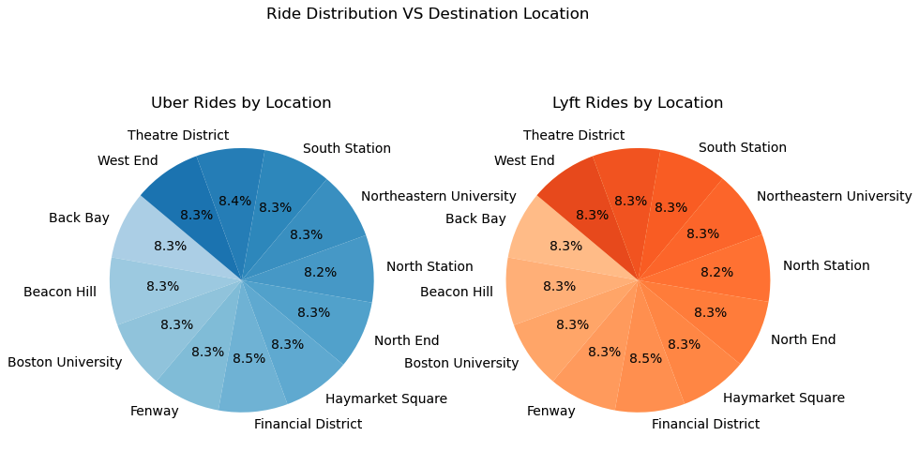
Ride distribution VS Destination Location for both Uber and Lyft
Analysis:
Both types, uber and Lyft, have an evenly distribution on location.
The data suggests that users of Uber and Lyft are equally likely to travel to various locations within the city, with no strong preference for one service over the other based on destination. (P value is larger than 0.05)
Notes:
Okay let's take a look at how ride distribution compares between Uber and Lyft across various destination locations in boston city. As you can see from the pie charts on the right, both Uber and Lyft rides are evenly distributed across several key locations, such as the Financial District, Beacon Hill, and South Station. Each location accounts for roughly 8-9% of rides, indicating that users of both services are equally likely to travel to these areas. This suggests that there is no strong preference for either Uber or Lyft based on the destination within the city. In fact, the statistical analysis supports this observation, with a p-value greater than 0.05. This means there is no significant difference in how rides are distributed based on location for the two services. In summary, whether you choose Uber or Lyft, the likelihood of being driven to any particular location within the city is about the same..

Slide 6
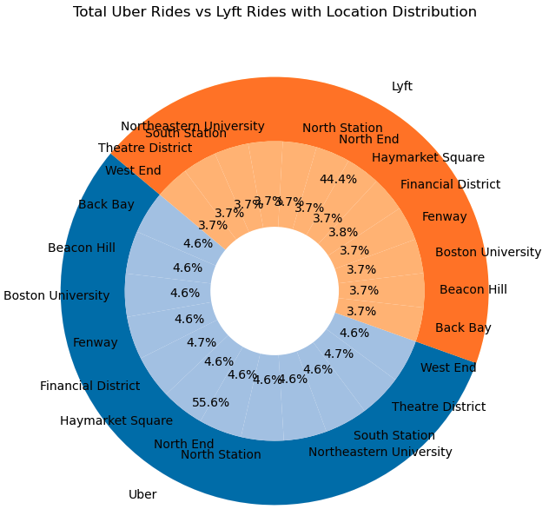
Detailed Ride Distribution VS Destination
Analysis:
From the West End all the way to Back Bay, Uber exhibits a slightly higher ride distribution compared to Lyft.
The impact of the location difference is very insignificant. We can continue analyze mean price among uber and lyft together.
Notes:
The ring chart on the right side provides a more granular view of the ride distribution by destination location for Uber and Lyft.(读slide) that part will be introduced to you by my teammate Sukhwinder.

Slide 7
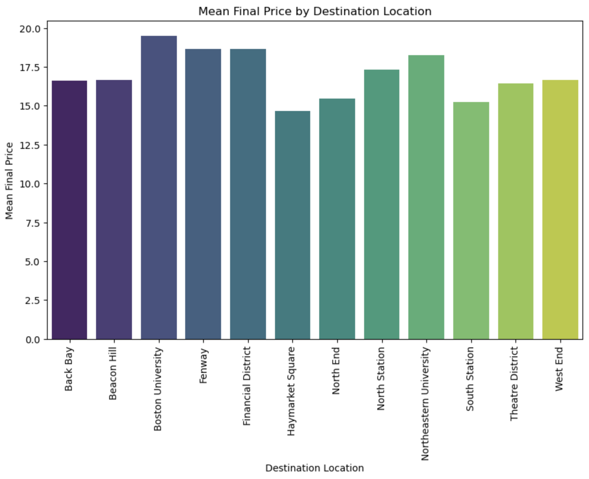
Mean Final Price By Destination Location
Analysis:
The Bar Graph Shows the mean price for different destinations in Boston City.
It shows the rides to the Boston University are costlier than all other locations.
Notes:
We created this bar graph by using price and surge multiplier data for every location.

Slide 8
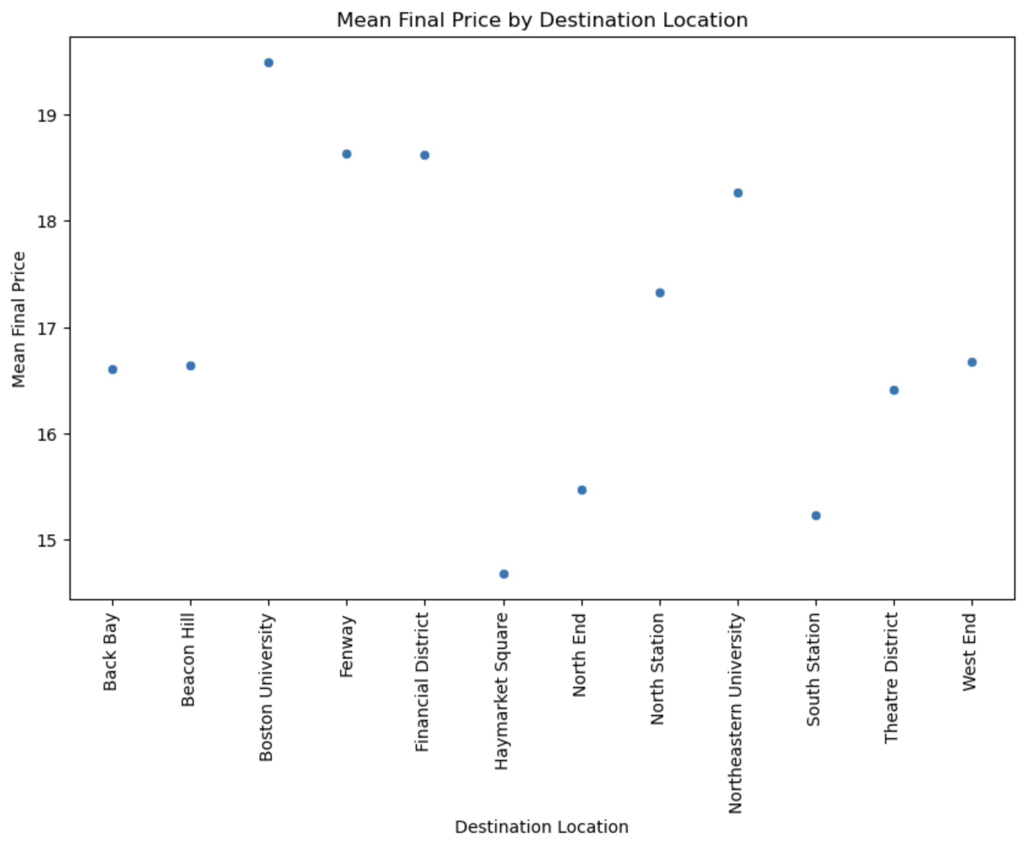
Surge Effect on Rides Price
Analysis:
Scatter plot gives us more detailed difference between the mean final price for different locations.
There is nearly a five dollar difference
between the prices of Haymarket square and Boston University. It shows that riders commute to the Boston University mostly in the peak hours when surge is in effect.

Slide 9
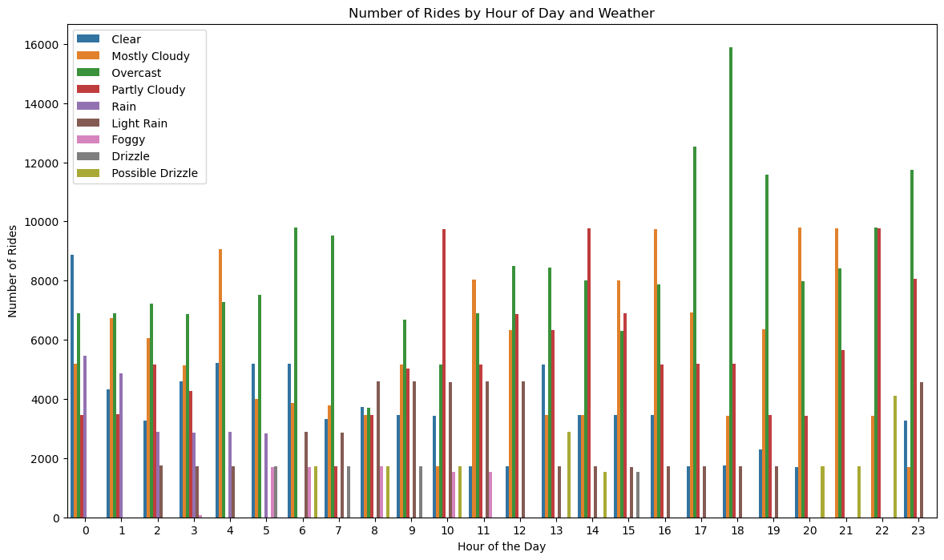
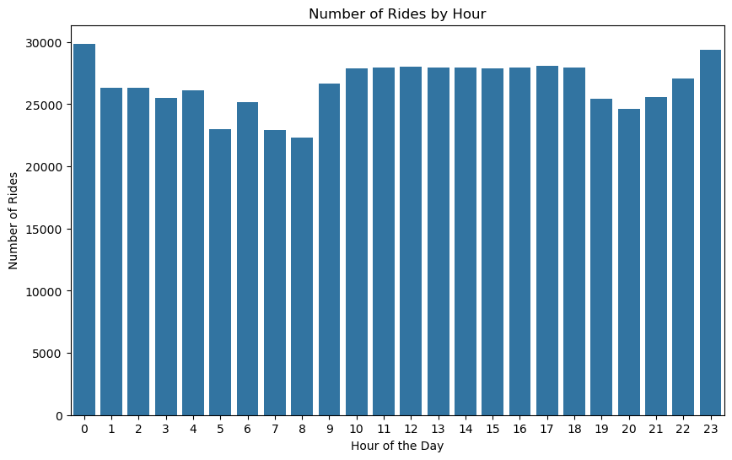
Ride Distribution in Relation to Weather
The Pearson correlation coefficient between time of day and number of rides is 0.16
Varying weather conditions at all hours of the day
More demand when there is overcast

Slide 10
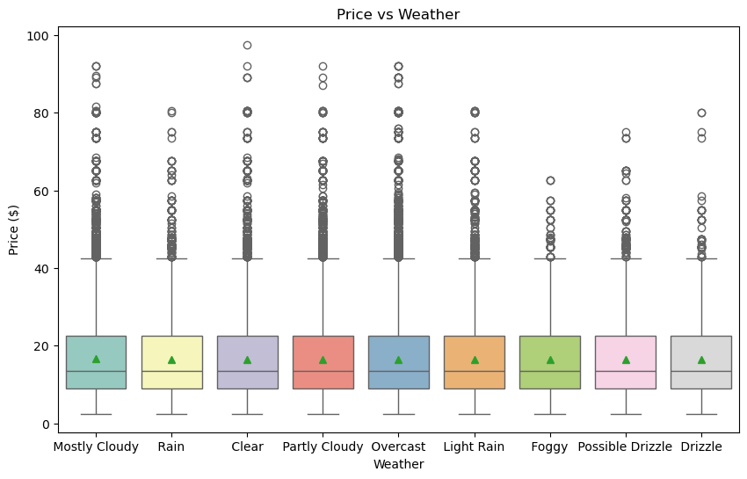
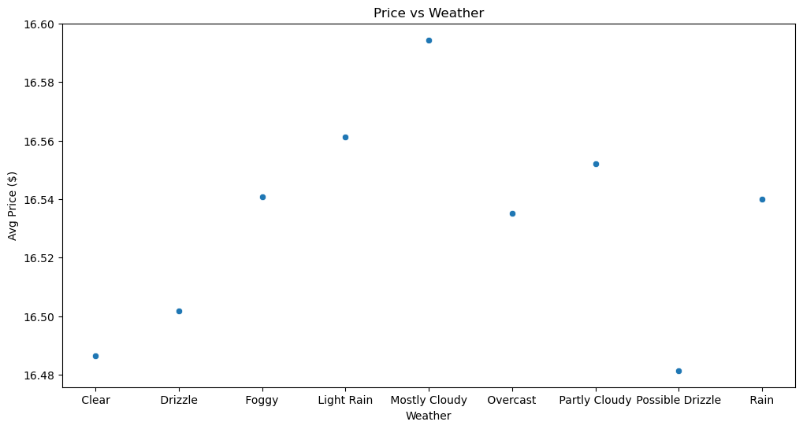
Price Distribution in Relation to Weather
Analysis:
Data is not normally distributed
Based on the average price for each of the weather conditions, weather does not appear to affect price

Slide 11
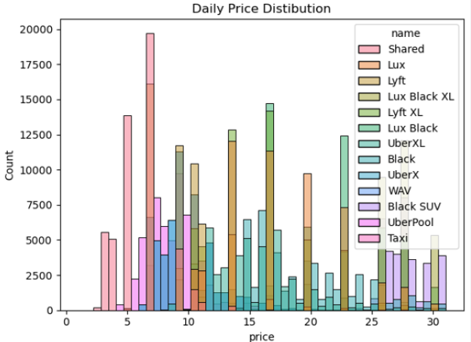
Daily Price Distribution by Vehicle Model Type
Analysis:
The histogram shows the distribution of daily prices across different service types.
The most frequent prices range from $5 to $15.
Shared rides and Lux services show distinct price peaks.
Higher prices are less common but visible in premium services like Lux Black and UberXL.
Notes:
Thank you for giving the opportunity, Let’s dive into an analysis of price distribution and the distribution of service types.This presentation will help us understand how these services are utilized and how their pricing structures are spread across different ride types. As, we can see from the Histogram, It illustrates how prices are spread out for each service. We can see that most rides fall within the $5 to $15 range, which includes both shared and standard services. Interestingly, we see distinct peaks for premium services like Lux Black and UberXL at higher price points. This indicates that while lower-priced options are more common, there's a significant demand for premium services, albeit at higher prices."

Slide 12
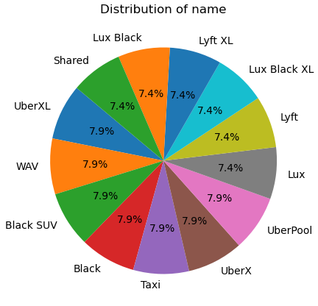
Distribution of Vehicle Model Type
Analysis:
The pie chart shows the percentage distribution of various ride services.
The distribution is relatively even among most Vehicle Model Type, with each comprising about 7-8% of the total.
Premium services like Lux Black and Lyft XL have slightly lower usage compared to standard options like UberX and Lyft
Notes:
Here, we have a pie chart that breaks down the distribution of different vehicle model types. The first thing to note is that the distribution is quite even, with each service type representing around 7 to 8 percent of the total rides. This suggests that no single service overwhelmingly dominates the market. However, premium services like Lux Black and Lyft XL are used slightly less frequently compared to more standard options like UberX and Lyft, reflecting a preference for more affordable rides among consumers."

Slide 13
Key recommendation
Pricing Strategy and Marketing at Boston University:Boston University has the highest average final ride price during peak time. To support students and encourage more of them to use these services, we recommend that ride-sharing companies reconsider these surcharges and explore more student-friendly pricing strategies to boost the revenue.
Focus on Affordable Ride Options: Offering discounts or loyalty programs for rides within the $5 to $15 range could further solidify their customer base in this segment.
No further investigation needs to be done on price related with weather and vehicle model types.
Notes:
Now let's turn our attention to the key recommendations. These recommendations are focused on two primary areas: enhancing affordability and refining our pricing strategy.

Slide 14
Thank you!
Q&A
Notes:
Thank you all for your time and attention today. (We've covered a lot of ground, from analyzing the current landscape to discussing key recommendations that can drive our strategy forward. )At this point, We’d like to open the floor for any questions please.

Slide 15
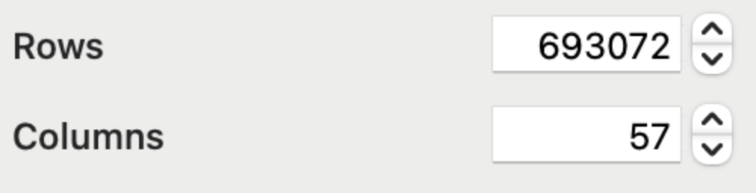
Reference
-Kaggle source:
https://www.kaggle.com/datasets/brllrb/uber-and-lyft-dataset-boston-ma
-Data size quick view:

